Slide 1
Multi-Spectral Thermal Infrared Imager for UAV Based Remote Sensing
Loren Larrieu
Mentors: Christopher Edwards & Aaron Weintraub
Arizona Space Grant Symposium
April 22nd 2023

Slide 2
Background
Thermal InfraRed (TIR) (Tempfli et al., 2009)
  Useful for gathering information about rock mineral composition, and required for assessing thermal energy processes on planetary bodies
Remote sensing
  Useful for imaging large landscapes and treacherous areas that are hard to reach

Slide 3


Background Cont.
Calibration Method (Edwards et al. 2021)
  Can use the calibration method for the EMIRS instrument that finds the radiance of a scene using two calibration targets with a known emissivity and plank radiance
  From the two calibration targets, an instrument response function(IRF) can be found and then used to calculate the absolute radiance of a scene
Notes:
two calibration targets and the raw voltage readings from the sensor

Slide 4
Objectives
Build a functional prototype of an inexpensive, multi-camera thermal infrared (TIR) imaging system for use on an Unmanned Aerial Vehicle (UAV) using commercially or otherwise widely available materials
improve image acquisition script
Calibrate image output utilizing the method used in Edwards et al. 2021

Slide 5
Motivation
Continuing work from last year
  Thermal infrared (TIR) spectroscopy provides important data for planetary science
  Remote sensing using Unmanned Aerial Vehicles (UAV’s) can provide valuable information for hard to reach places
Notes:
TIR: long history of use for surface characterization on analog sites and on other planetary bodies. Particularly useful in determining the mineral composition of rocks
RS using UAVs: Can help fill the gap between in-situ and satellite data (Alvarez-Vanhard et al. 2021), which is important for earth science and planetary science as a whole
Bandpass filters:custom filters provided by Andover. Chose a broad set of wavelengths within the range where the Earth radiates ambiently

Slide 6
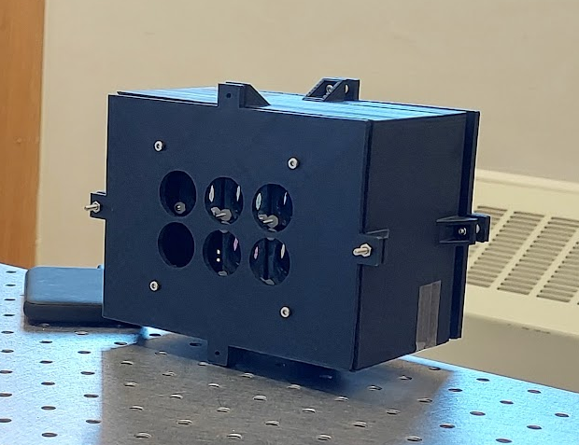
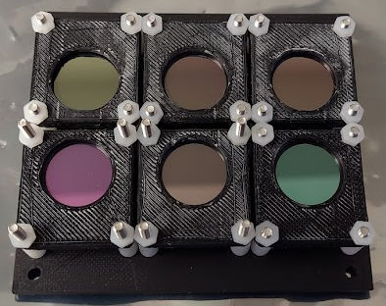
Build Process - Electronics and Physical Structure
Utilizes a Raspberry Pi 4 to power and control FLIR Lepton 3.5 thermal cameras
Andover Bandpass optical filters
  λ = [8030 nm,11350 nm] +- 100 nm
3D printed custom components
5V power supply required
Notes:
Pwr supply can be a power bank compatible with the Raspberry Pi, or UAV battery connected to a step-down transformer
Walk people through challenges in the design process

Slide 7

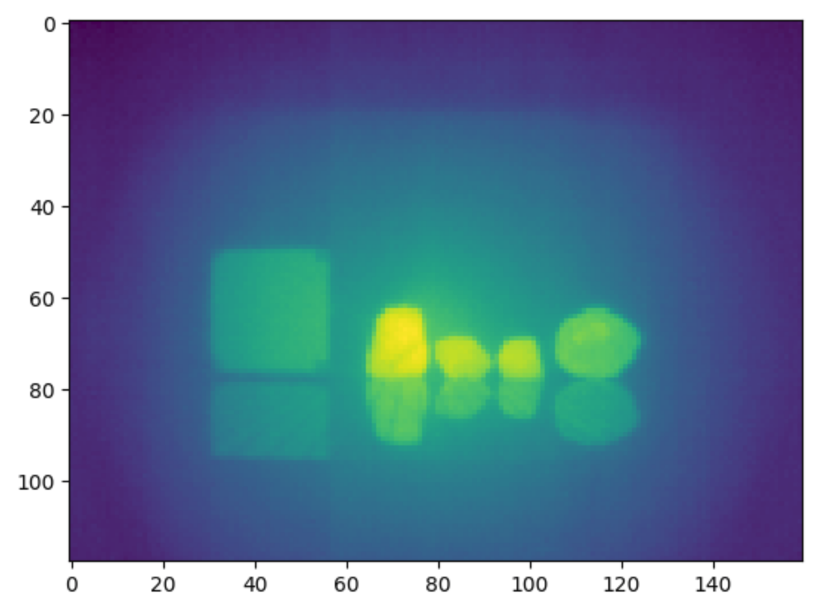
Build Process - Software
Data Acquisition
  Uses flirpy by Josh Veitch-Michaelis
    Allows for raw 16 bit value output from cameras
  Pseudo-synchronous image capture from array of Leptons using a for loop
    Loads data from each channel into a matrix then saved as a CSV
    This method noticeably reduced runtime of the acquisition script

Slide 8
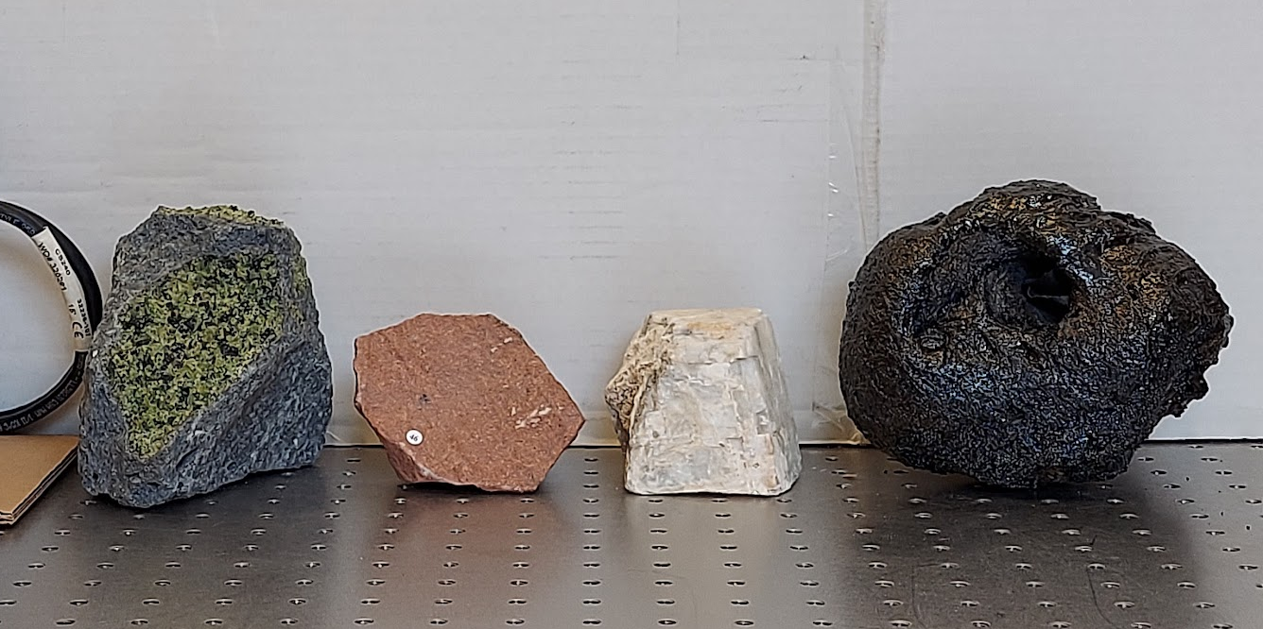
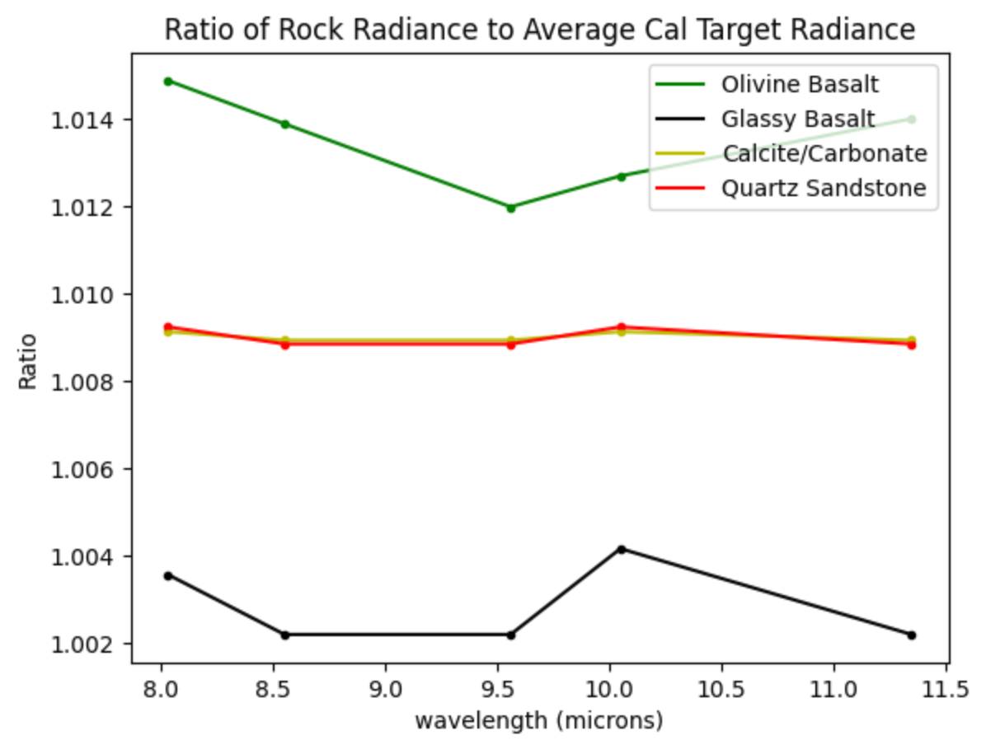

Build Process - Software Cont.
Calibration
  Requires data from a cal target set to two different temperatures to calibrate scene data
    Converts raw values into a voltage from each pixel
    Approximates radiance using:
    Calculates IRF using equation 3 from Edwards et al. 2021
  Converts raw scene data values into voltages and applies equation 4 from Edwards et al. 2021 to return scene radiance values from each pixel

Slide 9
Future Development
Still hope to incorporate a 6th Lepton and reduce run-time for the image acquisition script through process optimization
  Improve method for differentiating channels
In-field testing of the apparatus
  Attaching it to a UAV and flying it
Improve calibration script
  Handle missing/NaN pixels

Slide 10
Acknowledgements
NAU Space Grant Consortium & Department of Astronomy and Planetary Science
NASA
Andover Corporation & CanaKit
Paloma Davidson & my mentors

Slide 11
Thank You!
Questions?

